Slide 1
Chapter 13 Interfaces
Sections 13.5-13.8

Slide 2
Objectives
    To specify common behavior for objects using interfaces (§13.5).
    To define interfaces and define classes that implement interfaces (§13.5).
    To define a natural order using the Comparable interface (§13.6).
    To make objects cloneable using the Cloneable interface (§13.7).
    To explore the similarities and differences among concrete classes, abstract classes, and interfaces (§13.8).

Slide 3
Interfaces
An interface is a class-like construct for defining common operations for objects.
In many ways, an interface is similar to an abstract class, but the intent of an interface is to specify common behavior for objects of related classes or unrelated classes.
For example, using appropriate interfaces, you can specify that the objects are comparable, edible, cloneable using appropriate interfaces.

Slide 4
Define an Interface
An interface contains only constants and abstract methods.
modifier interface InterfaceName {
constant declarations;
abstract method signatures;
}
Example:
public interface Edible {
public abstract String howToEat();
}

Slide 5
Interface is a Special Class
An interface is treated like a special class in Java.
Each interface is compiled into a separate bytecode file, just like a regular class.
Like an abstract class, you cannot create an instance from an interface using the new operator, but you can use an interface more or less the same way you use an abstract class.
For example, you can use an interface as a data type for a variable.

Slide 6
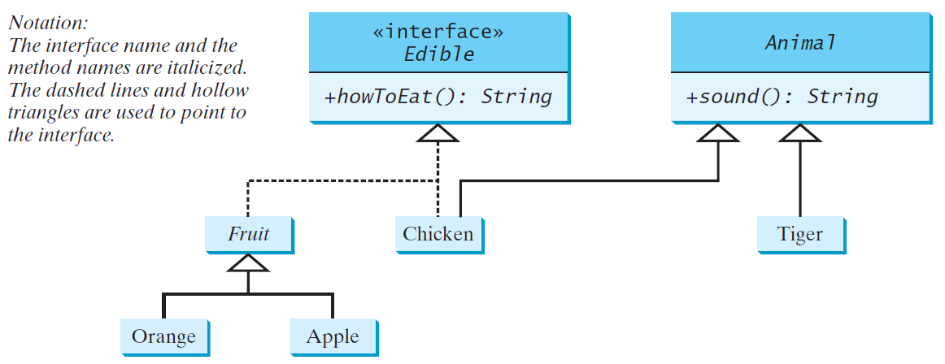
Example
You can now use the Edible interface to specify whether an object is edible. This is accomplished by letting the class for the object implement this interface using the implements keyword. For example, the classes Chicken and Fruit implement the Edible interface (See TestEdible).
Edible
TestEdible
Run

Slide 7

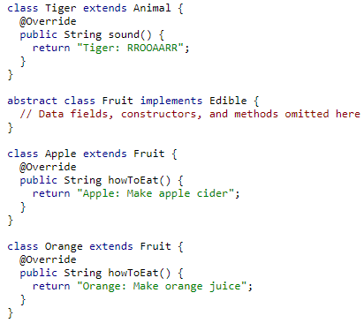
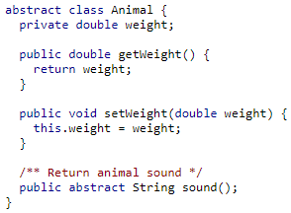
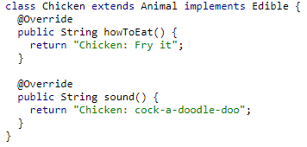
Example

Slide 8
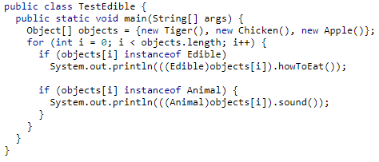
Example

Slide 9
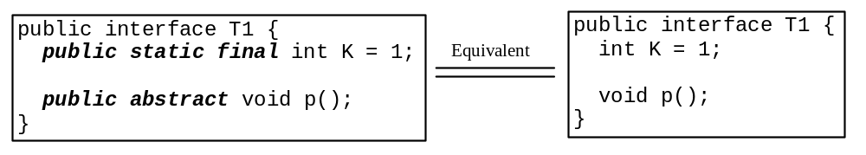
Omitting Modifiers in Interfaces
  All data fields are public final static and all methods are public abstract in an interface. For this reason, these modifiers can be omitted, as shown below:
  A constant defined in an interface can be accessed using syntax InterfaceName.CONSTANT_NAME (e.g., T1.K).

Slide 10
Example: The Comparable Interface
The Comparable interface defines the compareTo method for comparing objects.
// This interface is defined in java.lang package
package java.lang;
public interface Comparable<E> {
public int compareTo(E o);
}
The Comparable interface is a generic interface and the generic type E is replaced by a concrete type when implementing the interface.

Slide 11
The Comparable Interface contd…
Many classes in the Java library implement the Comparable interface to define a natural order for objects
For example, all the following classes implement the Comparable interface:
Byte, Short, Integer, Long, Double, Float, Character, BigInteger, BigDecimal, Calendar, String and Date

Slide 12
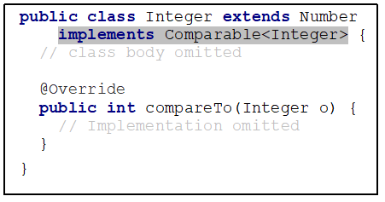
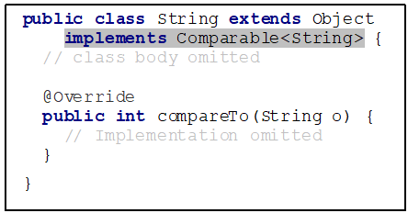
The Comparable Interface contd…
The compareTo() method returns a negative integer, zero, or a positive integer as this object is less than, equal to, or greater than the specified object.

Slide 13

Note
Let n be an Integer object. Then, all the following expressions are true.

Slide 14
Example
System.out.println(new Integer(3).compareTo(new Integer(5))); // -1
System.out.println("ABC".compareTo("ABE")); // -2 (Returns difference in ASCII value of first differing character)
java.util.Date date1 = new java.util.Date(2013, 1, 1);
java.util.Date date2 = new java.util.Date(2012, 1, 1);
System.out.println(date1.compareTo(date2)); //1

Slide 15
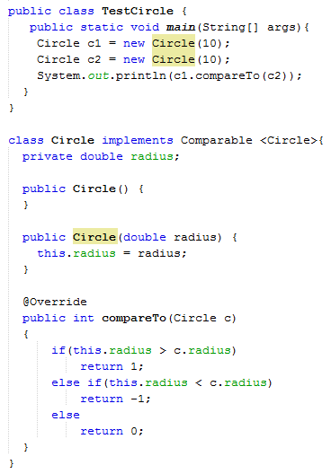
Example: Implementing Comparable in Circle class

Slide 16
Generic sort Method
Since all Comparable objects have the compareTo method, the java.util.Arrays.sort(array) method in the Java API uses the compareTo method to compare and sort the objects in an array, provided that the objects are instances of the Comparable interface.
The java.util.Arrays.sort(array) method requires that the elements in an array are instances of Comparable<E>.

Slide 17
Example: Using sort method with String objects
public static void main(String[] args) {
String[] cities = {"Savannah", "Boston", "Atlanta"};
java.util.Arrays.sort(cities);
for (int i=0; i<cities.length; i++)
System.out.println(cities[i]);
}

Slide 18
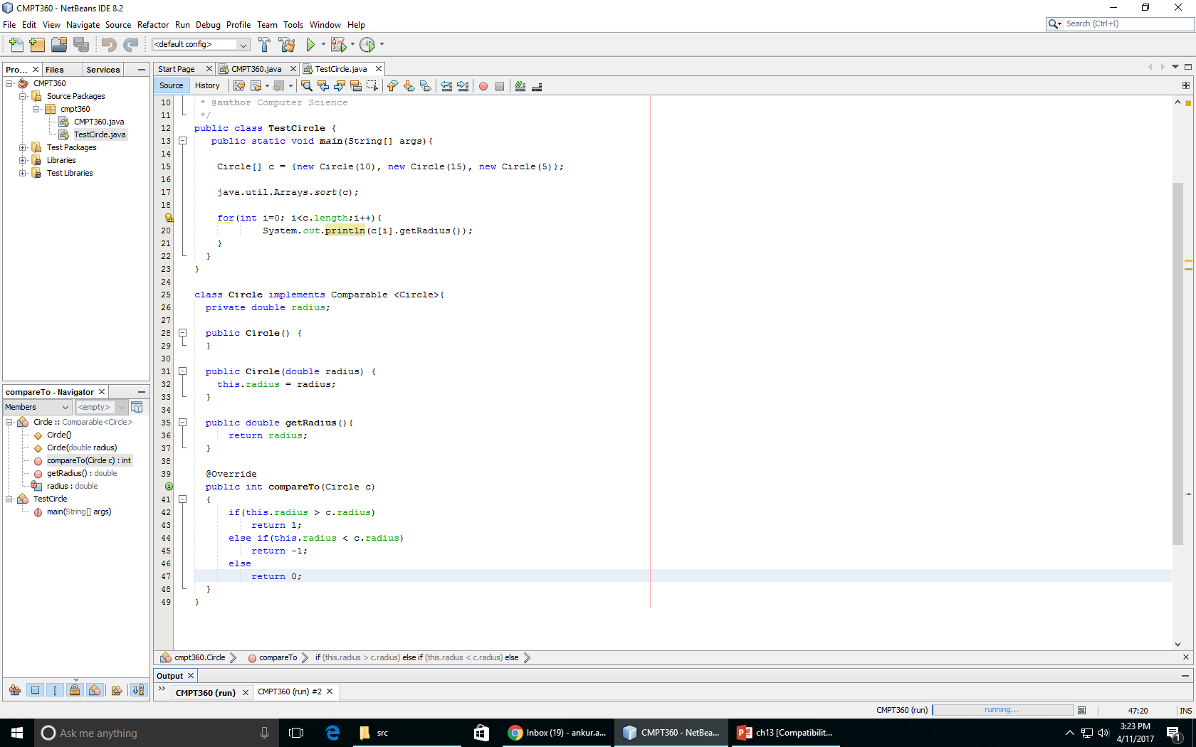
Example: Using sort method with Circle objects

Slide 19
The Cloneable Interfaces
  A marker interface is an empty interface and does not contain constants or methods.
  It is used to denote that a class possesses certain desirable properties.
  Example: Serializable, Cloneable and Remote interface
  A class that implements the Cloneable interface is marked cloneable, and its objects can be cloned using the clone() method defined in the Object class.

Slide 20
The Cloneable Interfaces
  Header of Clone method in Object class:
  protected Object clone() throws CloneNotSupportedException
  Cloneable interface:
  package java.lang;
  public interface Cloneable {
  }

Slide 21
Examples
Many classes (e.g., Date, Calendar, and Array) in the Java library implement Cloneable. Thus, the instances of these classes can be cloned. See the example below:
  Calendar calendar = new GregorianCalendar(2003, 2, 1);
  Calendar calendarCopy = (Calendar)calendar.clone();
  System.out.println(calendar == calendarCopy); //false
  System.out.println(calendar.equals(calendarCopy)); //true
  int[] luckyNumbers = { 2, 3, 5, 7, 11, 13 };
  int[] cloned = luckyNumbers.clone();
  for(int i=0; i<cloned.length;i++)
  System.out.println(cloned[i]);

Slide 22
Interfaces vs. Abstract Classes
  In an interface, the data must be constants; an abstract class can have all types of data.
  Each method in an interface is abstract; an abstract class can have concrete methods.
  An Interface cannot be instantiated using the new operator and there are no constructors. An abstract class cannot be instantiated but may have constructors.

Slide 23
Whether to use an interface or a class?
  Abstract classes and interfaces can both be used to model common features.
  How do you decide whether to use an interface or a class?
  In general, a strong is-a relationship that clearly describes a parent-child relationship should be modeled using classes. For example, apple is a fruit.
  A weak is-a relationship, also known as an is-kind-of relationship, indicates that an object possesses a certain property. A weak is-a relationship can be modeled using interfaces. For example, apple is edible.
  You can also use interfaces to circumvent single inheritance restriction if multiple inheritance is desired. In the case of multiple inheritance, you have to design one as a superclass, and others as interface.

Slide 24
Optional Exercise
  Implement an interface named Colorable with a void method named howToColor().
  Implement an abstract class named GeometricObject that has just one abstract method getArea() (no other methods, constructors and data fields).
  Implement a class named Square that extends GeometricObject and implements Colorable. Implement howToColor to display the message "Color all four sides". The Square class has a private double data field named side with its getter and setter methods. It has a no-arg constructor to create a Square with side 0, and another constructor that creates a Square with the specified side. It also implements the getArea() method to return the area of the square.
  Use the main method given in the next slide.

Slide 25
Optional Exercise
  public static void main(String[] args) {
  GeometricObject[] objects = {new Square(2), new Square()};
  for (int i = 0; i < objects.length; i++) {
  System.out.println("Area is " + objects[i].getArea());
  if (objects[i] instanceof Colorable)
  ((Colorable)objects[i]).howToColor();
  }
  }

